Slide 1

Dr.Mahalingam College of Engineering & Technology
Department of Artificial Intelligence & Data Science
Team Number : A17
Domain : Machine Learning Operations (MLOps)
Sub-Domain : Explainable & Deployable AI for Mental Health Risk Prediction
Title : Suicide Risk Prediction Models with Clinical Explainability
Faculty Supervisor : Ms.M. RAJALAKSHMI
Team Members : Maha mathesh raja B (727624BAD031)
irfan basha R (727624BAD009)
Sridhar M (727624BAD091)

Slide 2
.
Abstract:
Over 300 million people worldwide are affected by depression, with symptoms that have a major impact on patients and, in the worst cases, can lead to suicide.
As the severity of the disease increases over time, early detection can save a patient’s life. The disease is diagnosed by professionals using questionnaires that might be influenced by biases, and of which the accuracy and reliability are not guaranteed.
Due to the low level of preprocessing and the associated fast computing time and low computational intensity, our innovative approach can serve as a basis for applications in the real world. This enables patients with suitable hardware to recognize the disease themselves at an early stage and thus receive timely treatment to prevent further development.
However, the focus is not on the early detection of mild depression, which can be the entry point to major depression. In this work, we developed a deep learning based model using a 1D convolutional neural network to detect mild depression in resting-state electroencephalogram data. We evaluated the model using a realistic world-like dataset and were able to achieve a balanced accuracy of 69.21%

Slide 3
EXISTING SOLUTION :
Existing suicide risk prediction systems primarily use BERT, MentalBERT, and deep learning models for detecting suicidal ideation.
Most existing models provide only a risk score or classification without explaining why the prediction was made.
Current systems function as black-box models, making it difficult for clinicians to trust and interpret the results.
Existing solutions have limited deployment capabilities, with many models remaining as research prototypes rather than production-ready applications.
Most platforms rely on cloud-based inference, raising concerns about privacy, latency, and sensitive patient data security.
Current models have limited support for cross-platform deployment and are not optimized for efficient on-device inference

Slide 4
LITERATURE IDENTIFIED & FINDINGS :
Demonstrated that social media text can effectively identify suicidal ideation using Natural Language Processing techniques
Reviewed various ML and deep learning approaches, concluding that Transformer-based models outperform traditional machine learning methods
Showed that LSTM and CNN models can detect suicidal tendencies but struggle to capture long-range contextual information.
Proposed integrating domain knowledge with deep learning to improve suicide severity prediction and clinical relevance.
Presented LIME as a local explainability technique that helps interpret individual model predictions, improving transparency.
Introduced SHAP as an effective method for explaining AI model predictions by identifying the contribution of each input feature

Slide 5
PROPOSED SOLUTION :
Develop a Suicide Risk Prediction System using fine-tuned BERT/MentalBERT models to accurately identify suicidal ideation from text.
Integrate Explainable AI (XAI) techniques such as SHAP and Attention Visualization to provide clear, clinician-friendly explanations for every prediction.
Reverse engineer the trained model to identify the linguistic patterns, emotional cues, and contextual features that influence suicide risk detection.
Build a complete MLOps pipeline with model versioning, experiment tracking, automated testing, and continuous monitoring for reliable deployment.
Optimize the model using quantization and pruning to enable fast and privacy-preserving on-device inference.

Slide 6
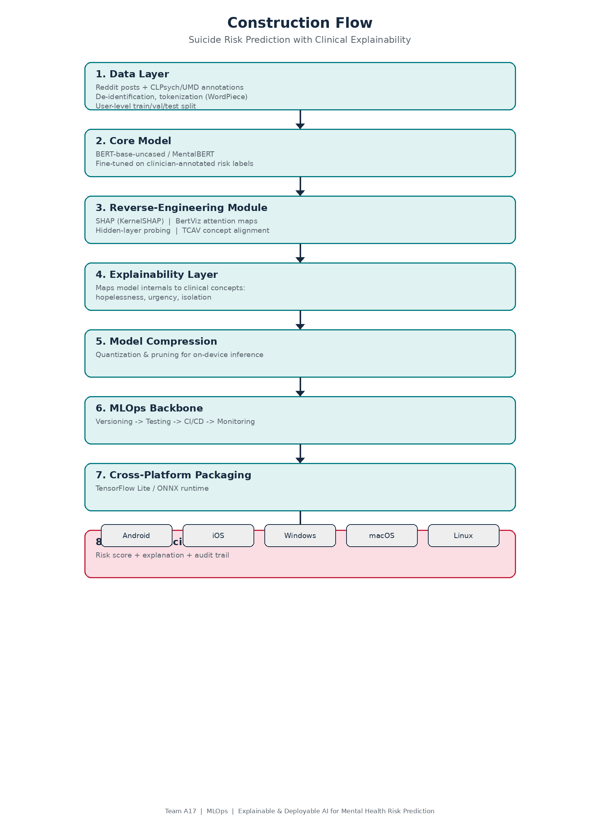
Block Diagram:

Slide 7
Tools Used:
Category | Tools | Category | Tools
Programming | Python | Container Platform | Docker
ModelOptimization | Quantization, Pruning | Target Platforms | Windows, Linux
Deep Learning | PyTorch, PyTorch Geometric | Deployment | ONNX Runtime, TensorFlow Lite (TFLite)
xplainable AI (XAI) | SHAP, BertViz | MLOps Platform | MLflow, Optuna

Slide 8
Expected Results:
Accurate suicide risk prediction using fine-tuned BERT/MentalBERT models with high precision and recall.
Clinically explainable predictions through SHAP and attention visualization, enabling healthcare professionals to understand model decisions.
Identification of key linguistic and emotional patterns associated with suicidal ideation by reverse engineering the model.
A complete MLOps pipeline for model training, versioning, monitoring, and reliable deployment.
Optimized on-device inference using model compression techniques, ensuring faster predictions while preserving user privacy.
Cross-platform deployment supporting Windows, and Linux.

Slide 9
Research Limitations:
Limited Dataset Diversity – Most publicly available datasets are collected from social media platforms (e.g., Reddit), which may not represent all demographic and clinical populations.
Black-Box Nature of Deep Learning Models – Although explainability techniques are used, they may not fully capture the complete reasoning behind model predictions.
Limited Clinical Validation – The system requires extensive evaluation and feedback from mental health professionals before real-world clinical adoption.
Language Dependency – The current model is primarily trained on English text and may not generalize well to other languages without retraining.
Risk of Prediction Errors – False positives and false negatives may occur, making the model unsuitable as the sole basis for clinical decision-making.

Slide 10
Challenges, Lessons & Roadmap Ahead
Next Steps for improving:
Complete full MLOps pipeline and CI/CD.
Expand to multimodal (text + EEG if available).
Larger clinician feedback loop for explanations.
Full cross-platform testing and adversarial robustness hardening.
Prepare for conference submission with quantitative benchmarks.
Plan of Implementation in the Operating System:
Use eBPF + kprobes as the Core Engine (Safe, powerful, and production-grade)
Use inotify or D-Bus to watch specific allowed directories/files (with permission)
Rate limiting on monitoring.
Kill switch and audit logs for the user.

Slide 11
Literature Survey
Pascal Penava et al.(2025)—Early-Stage Non-Severe Depression Detection Using a Novel CNN Approach on Resting-State EEG Data (2024) — IEEE.
Ji et al. (2021) — Review of machine learning methods for suicidal ideation detection.
Ophir et al. (2020) — Deep neural networks applied to Facebook posts for risk detection.
Tadesse et al. (2020) — Deep learning approaches on social media forums.
Gaur et al. (2019) — Knowledge-aware severity assessment of suicidal ideation.
Coppersmith et al. (2018) — NLP of social media for suicide risk screening.
Lundberg & Lee (2017) — SHAP: A unified approach to interpreting model predictions.
Ribeiro et al. (2016) — LIME: Explaining the predictions of any classifier.

Slide 12
References
Book References:
Molnar, C. (2022). Interpretable Machine Learning: A Guide for Making Black Box Models Explainable (2nd ed.). independently published.
Web References:
Pascal Penava et al.(2025) — Early-Stage Non-Severe Depression Detection Using a Novel CNN Approach on Resting-State EEG Data — https://ieeexplore.ieee.org/document/10757418
Coppersmith et al. (2018) — https://journals.sagepub.com/doi/full/10.1177/1178222618792860
Ji et al. (2021) — https://ieeexplore.ieee.org/document/9199553

Slide 13
THANK YOU

